Slide 1
MCA Final Year Project (Review I) AI-Powered Virtual Health Assistant
Submitted to the Presidency University, Bengaluru in partial fulfillment for the award of the degree of Master of Computer Applications(MCA)
Project Number : 222
Under the supervision of
Mr. Sakthi S Asst. Prof, Department of SCSE School of Computer Science and Engineering
Name | Roll Number
Latha Kamath M K | 20232MCA0058

Slide 2
Content
Problem Statement
Literature Survey
Tools and Technologies to be used
Timeline of the Project
GitHub
References

Slide 3
Problem Statement
Healthcare Challenges: Overburdened systems, lack of expertise in remote areas, high costs, and privacy concerns.
Limitations of Traditional Services: Long waiting times, limited doctor availability, and poor medical record management.
AI-Powered Solution: NLP and ML for symptom analysis, AI consultations, and real-time doctor recommendations.
Blockchain for Security: Secure, tamper-proof medical record management ensuring data privacy.
Accessibility and Affordability: Web and mobile apps for convenient, efficient, and affordable healthcare.

Slide 4
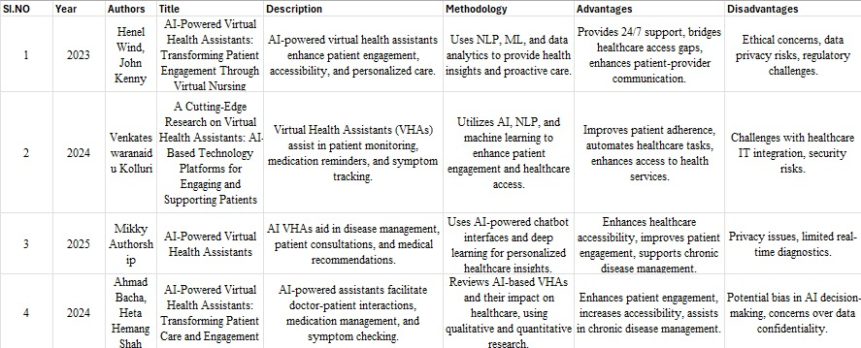
Literature Review

Slide 5
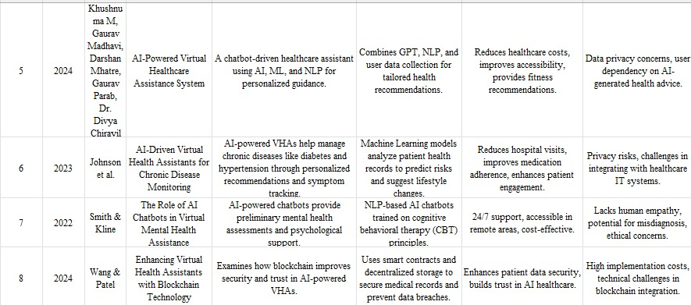

Slide 6
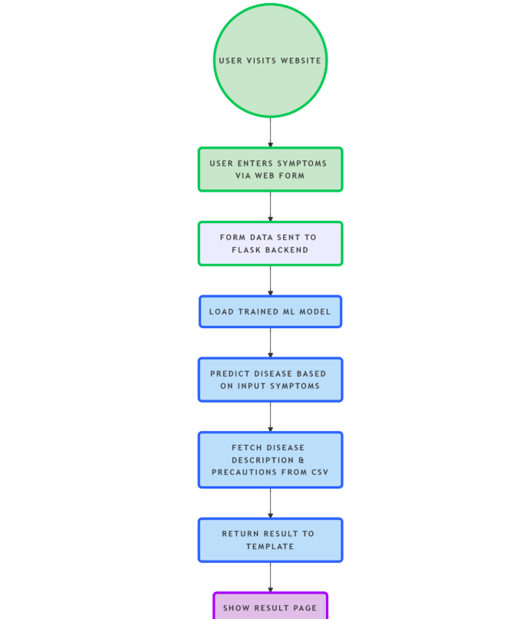
Module Design

Slide 7
User Visits Website → The user opens the web application to access the symptom checker.
User Enters Symptoms via Web Form → The user inputs symptoms through a frontend form on the homepage.
Form Data Sent to Flask Backend (/home) → The submitted form data is routed to a Flask endpoint for processing.
Load Trained ML Model (model.pkl) → The backend loads a pre-trained machine learning model using pickle.
Predict Disease Based on Input Symptoms → The model predicts a probable disease based on the user's input.

Slide 8
6. Fetch Disease Description & Precautions from CSV → Descriptive and precautionary information is retrieved from a dataset.
7. Return Result to Template (disease, desc, precautions) → The backend sends the prediction and details to the frontend template.
8. Show Result Page (index.html updated) → The final prediction and advice are displayed back to the user.

Slide 9
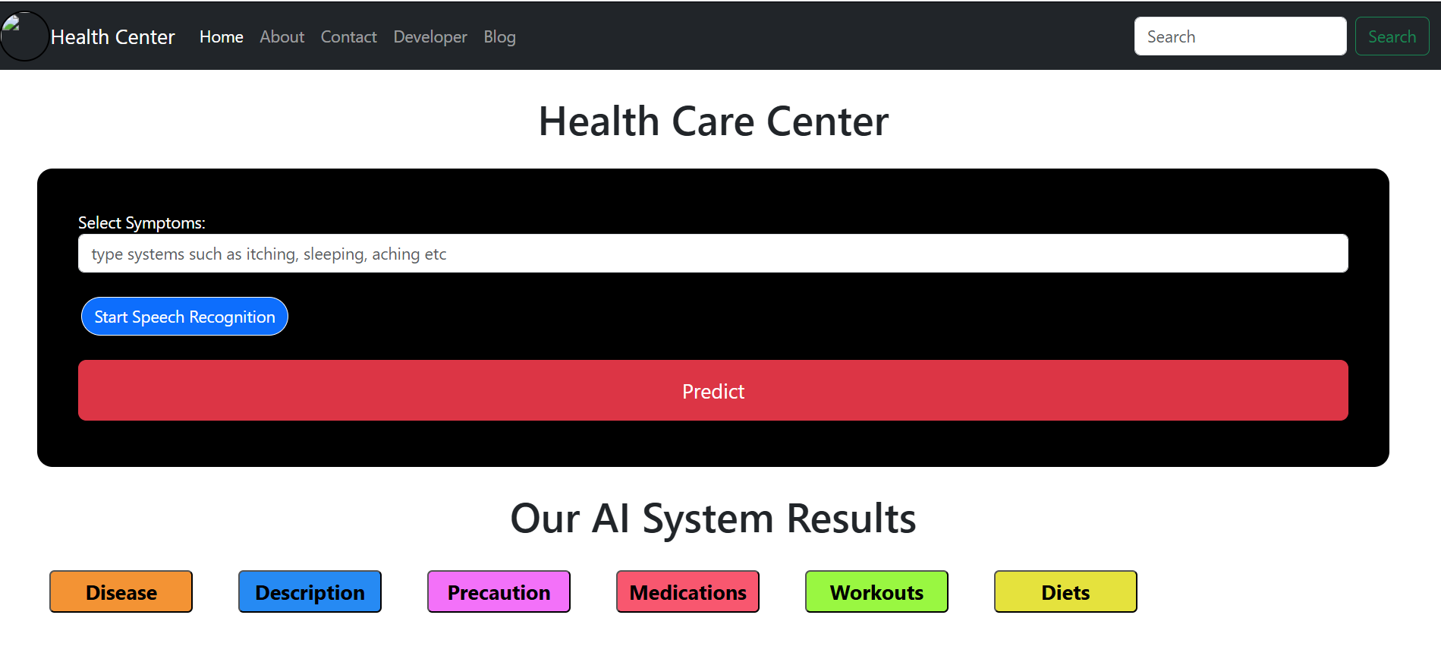
Modular Breakdown
Module 1: User Interface (Frontend)
Function: Provides an HTML-based frontend (index.html, about.html, etc.) for users to input symptoms and view results.

Slide 10
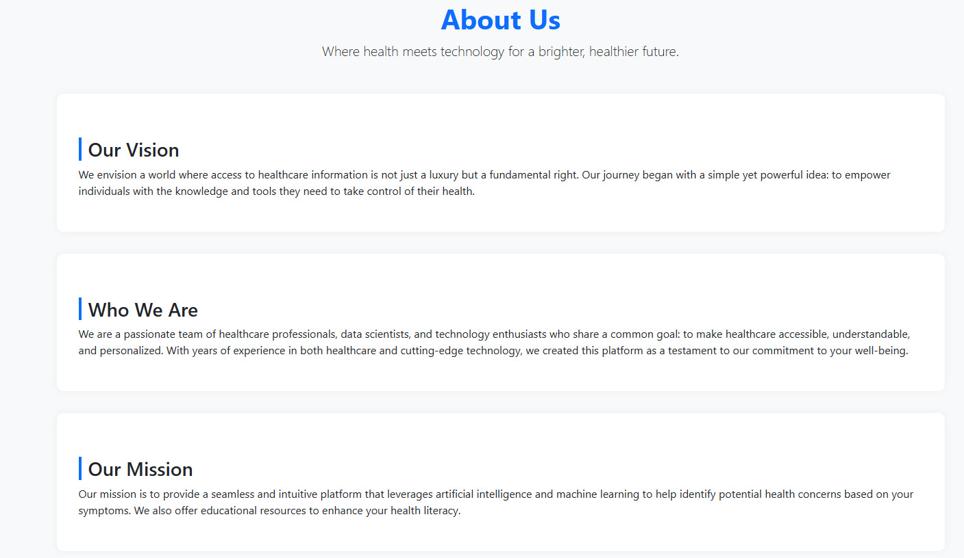
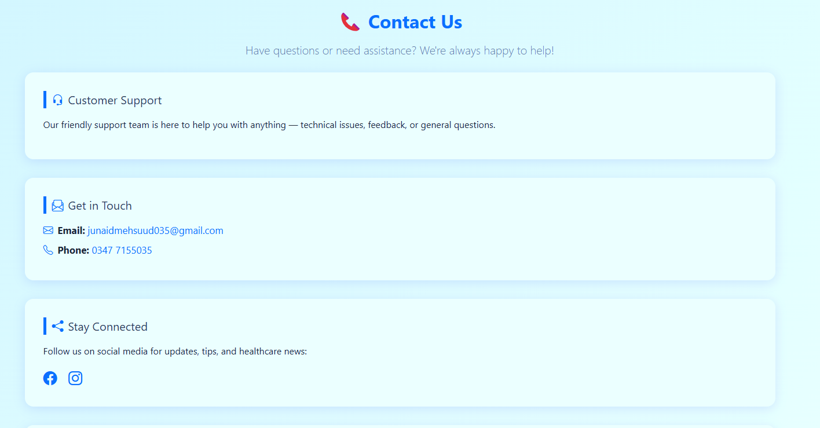

Slide 11
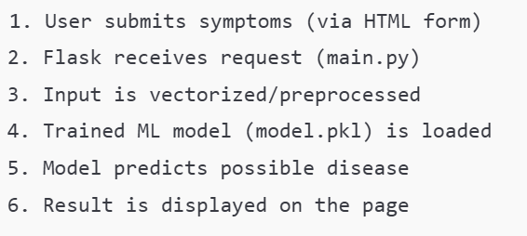
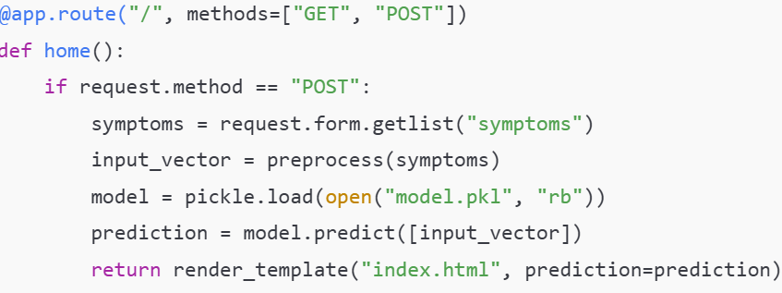
Module 2: Backend Processing & Prediction
Function: Uses Flask (main.py) to handle requests, process input, load the trained ML model, and predict the disease based on user symptoms.

Slide 12
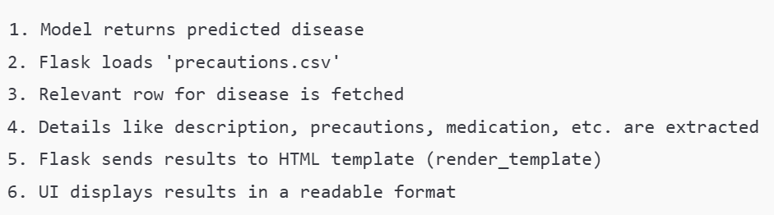
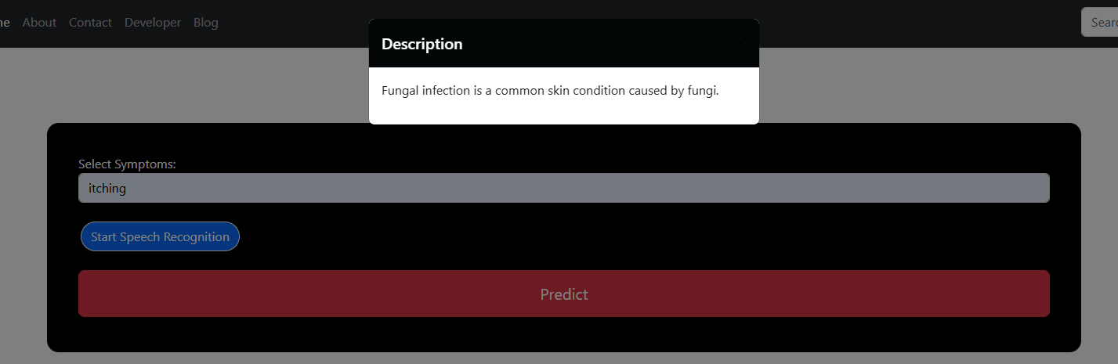
Module 3: Output Rendering & Information Display
Function: Retrieves relevant health data (description, precautions) from precautions.csv and displays prediction results and advice on the frontend.

Slide 13
Tools And Technologies To Be Used
Flask:
Backend web framework for handling HTTP requests and routing.
Python:
Core programming language for backend logic and machine learning integration.
Pandas:
For reading and processing structured data from CSV files.
Scikit-learn / Trained ML Model:
Used for making disease predictions based on symptoms.
HTML, CSS, Bootstrap 5:
For designing a responsive and styled frontend interface.

Slide 14
Jinja2:
Templating engine for dynamic rendering of prediction results on HTML pages.
CSV Files:
Contain symptom-disease mappings, disease descriptions, and precautions.
PyCharm:
Integrated Development Environment (IDE) for developing and debugging the application.
Virtual Environment (venv):
For managing project-specific dependencies and isolating the development environment.

Slide 15
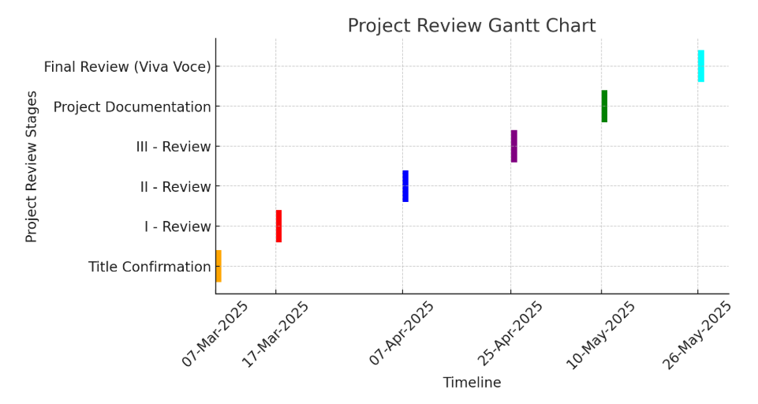
Timeline of the Project

Slide 16
GitHub Link
Lathakamathmk/AI-Powered-Virtual-Health-Assistant- · GitHub

Slide 17
References
1. H. Wind and J. Kenny, "AI-Powered Virtual Health Assistants: Transforming Patient Engagement Through Virtual Nursing," 2023.
Discusses AI-powered virtual health assistants' role in enhancing patient engagement and personalized care using NLP, ML, and data analytics.
2. V. Kolluri, "A Cutting-Edge Research on Virtual Health Assistants: AI-Based Technology Platforms for Engaging and Supporting Patients," 2024.
Explores how AI-driven VHAs assist in patient monitoring, medication reminders, and symptom tracking through AI, NLP, and machine learning.
3. M. Authorship, "AI-Powered Virtual Health Assistants," 2025.
Examines AI-driven VHAs in disease management, consultations, and medical recommendations with chatbot-based interactions and deep learning.
4. A. Bacha and H. H. Shah, "AI-Powered Virtual Health Assistants: Transforming Patient Care and Engagement," 2024.
Reviews AI-based VHAs for improving doctor-patient interactions and chronic disease management using qualitative and quantitative research.

Slide 18
K. M., G. Madhavi, D. Mhatre, G. Parab, and D. Chiravil, "AI-Powered Virtual Healthcare Assistance System," 2024.
A chatbot-driven AI-powered healthcare assistant integrating GPT, NLP, and ML for personalized health recommendations.
6. Johnson et al., "AI-Driven Virtual Health Assistants for Chronic Disease Monitoring," 2023.
Investigates AI-powered VHAs for managing chronic diseases such as diabetes and hypertension using ML-based patient record analysis.
7. Smith and Kline, "The Role of AI Chatbots in Virtual Mental Health Assistance," 2022.
Focuses on NLP-based AI chatbots trained on cognitive behavioral therapy (CBT) principles for mental health support.
8. Wang and Patel, "Enhancing Virtual Health Assistants with Blockchain Technology," 2024.
Examines the integration of blockchain technology for security and trust in AI-powered VHAs using smart contracts and decentralized storage.

Slide 19


